Slide 1
Computer Organisation
Topic 1
Introduction
(Part 2)
Stallings, Computer Organization & Architecture (9th Ed.), Chap. 2

Slide 2
Outline
History of computers
X86, PowerPC and ARM evolution
Organisation and architecture
Structure and function
Computer evolution and performance
Cloud Computing
Performance Issues

Slide 3
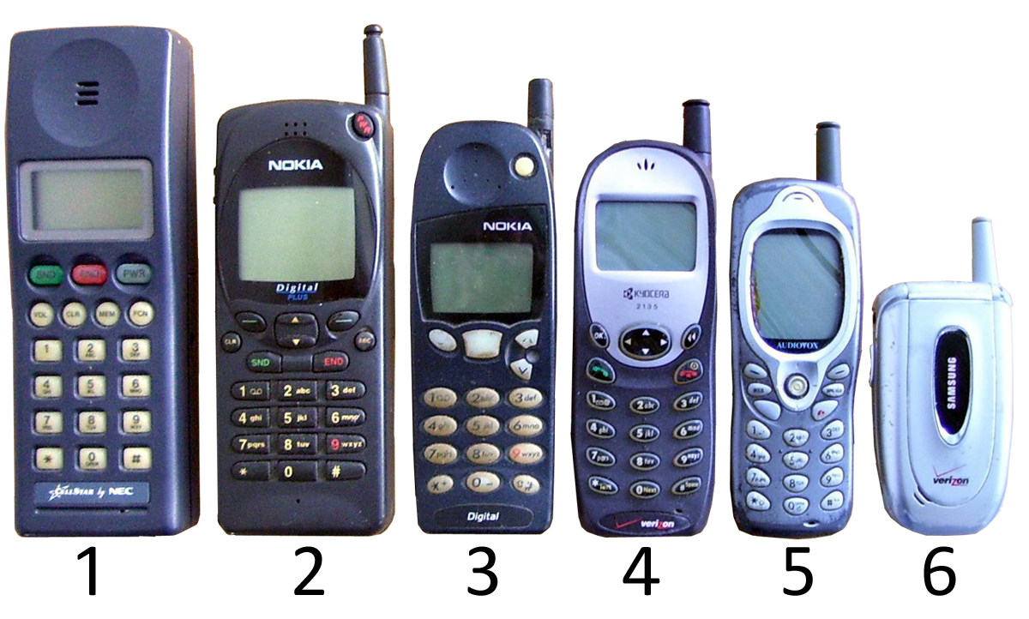
What mobile phone are you using?
Image source: https://commons.wikimedia.org/wiki/File:Mobile_phone_timeline.png

Slide 4
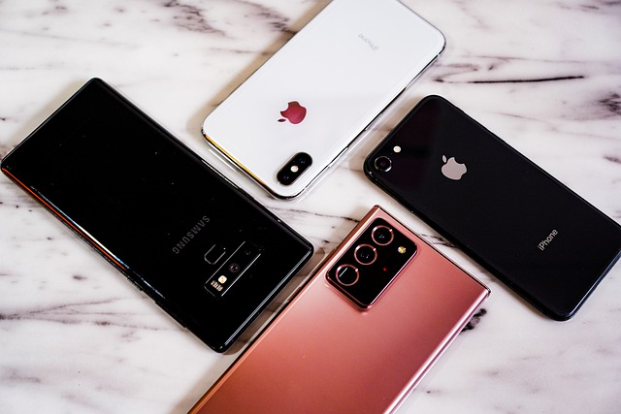
What mobile phone are you using?
Image source: https://pixabay.com/photos/cellphones-smartphones-mobile-phones-5507342/

Slide 5
What processor does it use?
Image source: https://pixabay.com/photos/cellphones-smartphones-mobile-phones-5507342/

Slide 6
Computer Generations
1st Generation Vacuum Tube
2ndGeneration Transistors
3rd Generation Integrated Circuits
Later Generation Semi-conductor
Microprocessor

Slide 7
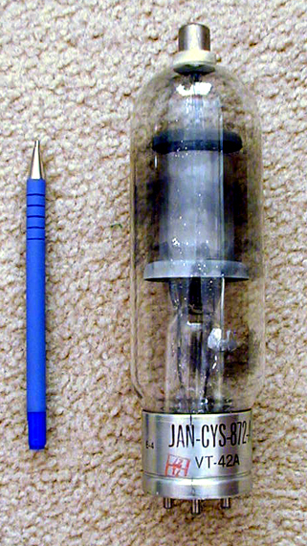
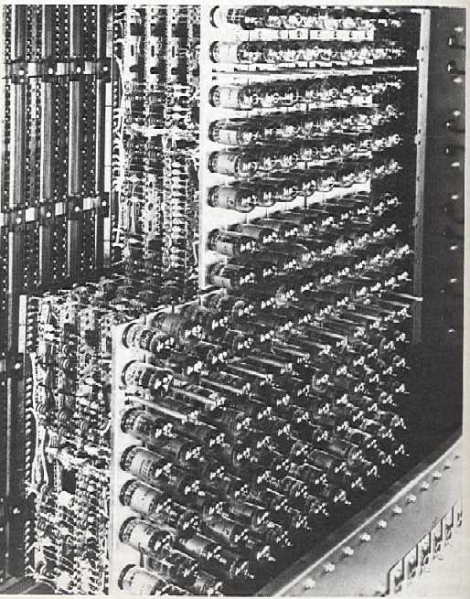
The First Generation: Vacuum Tubes
Invented in 1906
Produced a large amount of heat & costly to operate
Widely use in electronic devices such as TVs, radios and X-ray machines
Dependent on the machine language
Not able to perform multitasking
UNIVAC vacuum tube
http://www.computermuseum.li/Testpage/UNIVAC-VacuumTube.htm
IBM 701 panel
http://www.columbia.edu/acis/history/701-tubes.html

Slide 8
ENIAC Background
Electronic Numerical Integrator And Computer (ENIAC)
First general-purpose digital computer
Was built during WWII
Eckert and Mauchly
University of Pennsylvania
It was programmed to compute the values of artillery range tables
It was the most powerful calculating device built to date
It was the first programmable general-purpose electronic digital computer
Notes:
8

Slide 9
ENIAC Background
Started 1943, finished 1946
Too late for war effort
Hence, used to study hydrogen bomb – regarded as general-purpose.
Its first task was doing calculations for the construction of a hydrogen bomb
Used until 1955
Notes:
9

Slide 10
ENIAC Details
Decimal (not binary)
20 accumulators of 10 digits
Programmed manually by switches
“Programming” is tedious
18,000 vacuum tubes
30 tons
1500 square feet
140 kW power consumption
5,000 additions per second
Notes:
10
ENIAC: the first programmable, electronic, general-purpose digital computer) used vacuum tubes for digital logic elements and memory.

Slide 11
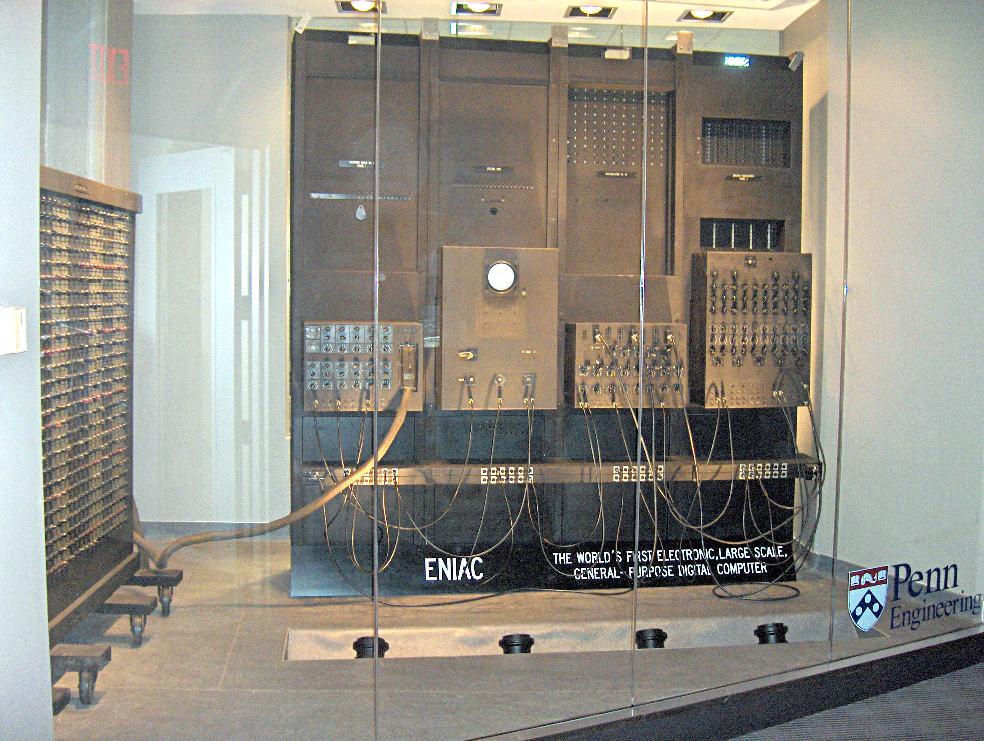
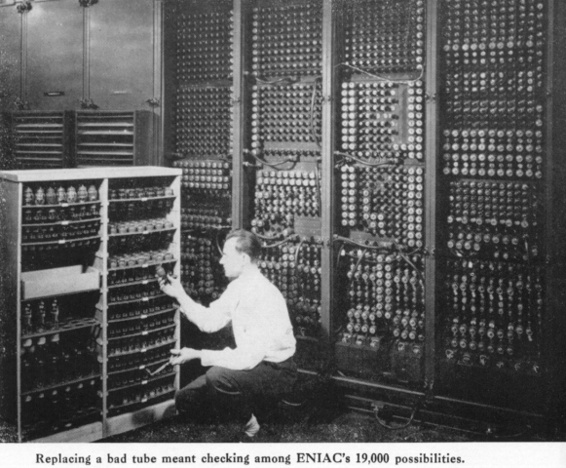
ENIAC 18,000 vacume tubes
Notes:
https://www.youtube.com/watch?v=k4oGI_dNaPc

Slide 12
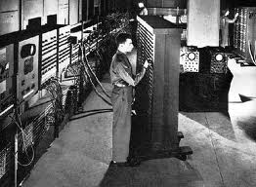
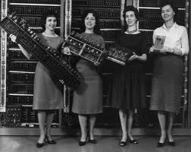
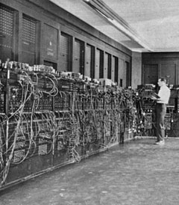
ENIAC 15,000 square feet

Slide 13
von Neumann/Turing
“blueprint” to describe a machine
A combination of von Neumann architecture and Turing machine
Von Neumann
Turing
CPU – executing instructions and performing calculations
Memory – stores instructions and data
CU – Interprets and executes instructions
ALU – Performs arithmetic and logical operations
Theoretical model of computation
Simulate any algorithmic process and serves as a theoretical foundation
Notes:
13
Stored Program concept
Main memory storing programs and data
ALU operating on binary data
Control unit interpreting instructions from memory and executing
Input and output equipment operated by control unit

Slide 14
von Neumann/Turing
IAS
was designed and built at the Institute for Advanced Study in the early 1950s by a team of researchers that included John von Neumann, Herman Goldstine, and J. Robert Oppenheimer.
First stored-program computer concept (both instructions and data could be stored in the same memory)
Designed at Princeton Institute for Advanced Studies
The prototype of the present computers
Started in 1946, completed in 1952
IAS computer is known as the stored-program concept
*IAS = Institute for Advanced Study
Notes:
14
The stored-program concept is a fundamental principle in the design and operation of modern digital computers.
It refers to the idea that both the program instructions and data used by a computer are stored in the same memory, and the computer can manipulate and process these instructions just like it would with any other data.
In other words, the instructions for the computer's operations are treated as data that can be accessed, fetched, and executed by the central processing unit (CPU).

Slide 15
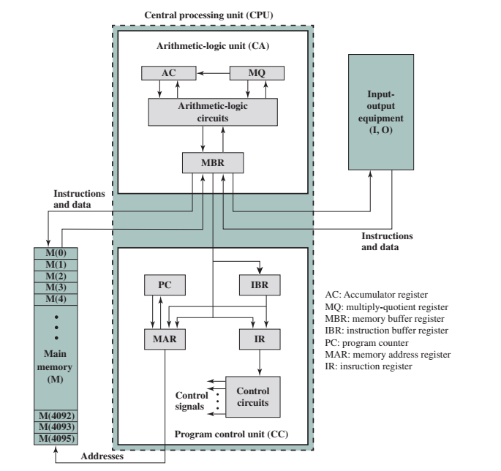
IAS structure
Notes:
15

Slide 16



IAS key concepts
Data and instructions both, are stored in a single read–write memory.
The contents of this memory are addressable by location.
Execution occurs sequentially from one instruction to the next.
Notes:
16

Slide 17

IAS Details
IAS memory consists of 4096 storage locations
1000 x 40 bit words
Binary number
2 x 20-bit instructions
CU operates the IAS by fetching instructions from memory and executing them one at a time
Set of registers (storage in CPU)
Memory Buffer Register (data)
Memory Address Register (address)
Instruction Register (instructions)
Instruction Buffer Register (temporary instructions)
Program Counter (address of next instruction)
Accumulator
Multiplier Quotient
Hold temporary operands and results of ALU operations
Notes:
17
Memory buffer register (MBR): Contains a word* to be stored in memory or sent to the I/O unit
Memory address register (MAR): Specifies the address in memory of the word to be written from or read into the MBR.
Instruction register (IR): Contains the 8-bit opcode (operation code) of the instruction being executed.
Instruction buffer register (IBR): Employed to hold temporarily the right-hand instruction from a word in memory.
Program counter (PC): Contains the address of the next instruction pair to be fetched from memory.
Accumulator (AC) and multiplier quotient (MQ): Employed to hold temporarily operands and results of ALU operations.

Slide 18
Commercial Computers
1947 - Eckert-Mauchly Computer Corporation
UNIVAC I (Universal Automatic Computer)
First successful machine to be commercialized
Commissioned by US Bureau of Census 1950 calculations
Became part of Sperry-Rand Corporation
Notes:
18

Slide 19
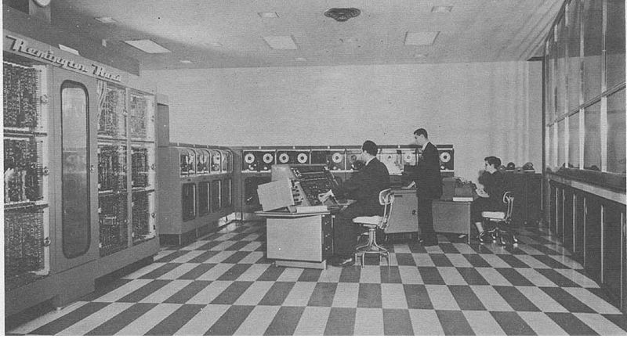
UNIVAC I
UNIVAC I at Franklin Life Insurance Company

Slide 20
UNIVAC II
Late 1950s
Faster & more memory
Upward compatibility (programs on old machine can run on the new machines)
UNIVAC 1100 series
Scientific applications

Slide 21
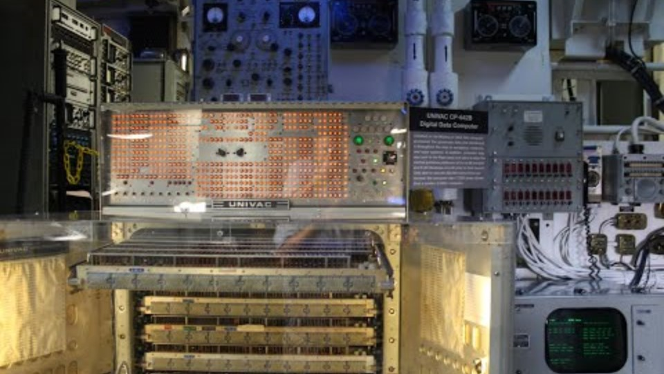
UNIVAC

Slide 22
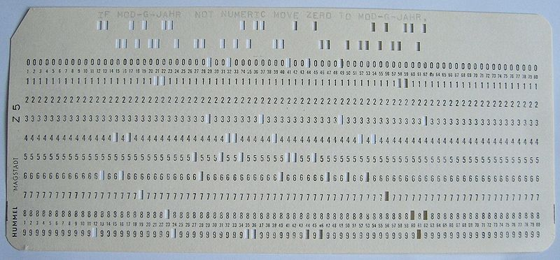
IBM
Major manufacturer of the punched-card processing equipment
1953 - the 701
IBM’s first stored program computer
Scientific calculations
1955 - the 702
Business applications
Lead to 700/7000 series
IBM 701 panel
http://www.columbia.edu/acis/history/701-tubes.html
Source: https://commons.wikimedia.org/wiki/File:Punch-card-cobol.jpg
Notes:
22
Punched-card processing equipment refers to a set of machines and tools that were used to process data stored on punched cards, also known as punch cards or perforated cards.
Punched cards are pieces of stiff paper or cardboard with holes punched in specific positions to represent data or instructions.

Slide 23
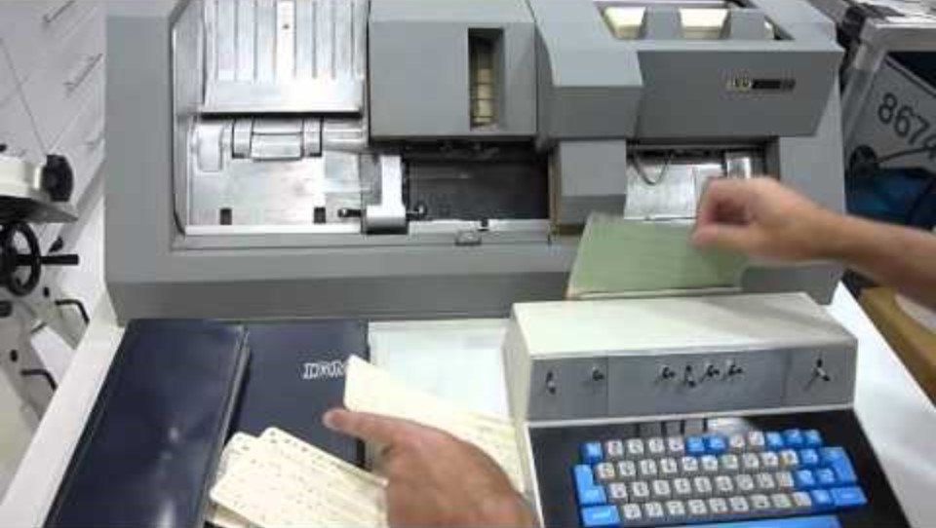
IBM punched-card processing equipment

Slide 24

What is a vacuum tube?
Source: https://www.flickr.com/photos/nubui/9550939064

Slide 25
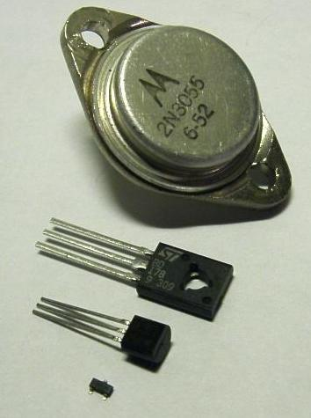
The Second Generation: Transistors
Replaced vacuum tubes
First major change for the electronic computer
Transistors are:
Smaller
Cheaper
Less heat dissipation
Solid state device, made from silicon (sand)
Invented 1947 at Bell Labs, William Shockley et al.
Transistors
http://en.wikipedia.org/wiki/Transistor
Notes:
25

Slide 26
Transistor Based Computers
Marked the second-generation machines
NCR & RCA produced small transistor machines
IBM 7000
DEC - 1957
Produced PDP-1
Introduction of more complex ALU and control units
Notes:
26

Slide 27
Transistor Based Computers
Use high-level programming language
Provided with system software
Better performance, larger memory, smaller size
But transistors (and other components) were discrete components (separate)
Problem when there are tens and hundreds of these components
Notes:
27

Slide 28
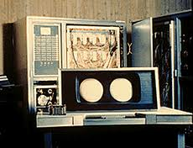
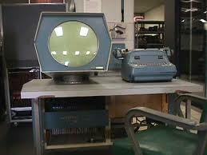
Transistor Based Computers
IBM 7000
PDP-1
PDP-1 Demo Video

Slide 29
What is a transistor?
Source: https://www.flickr.com/photos/nubui/9550939064

Slide 30
The Third Generation: Integrated Circuits
Microelectronic
Literally means “small electronics”
A computer is made up of:
Gates
Implement Boolean or logical function, control data flow
Memory cells
Stores 1 bit of data each
Interconnections
Notes:
30

Slide 31
Integrated Circuits
Remember the 4 functions?
Data storage (memory cells)
Data processing (gates)
Data movements (paths between components, through gates),
Control (paths carry control signal, activity is carried out with control signal)
These can be manufactured on a semiconductor
E.g. silicon wafer

Slide 32
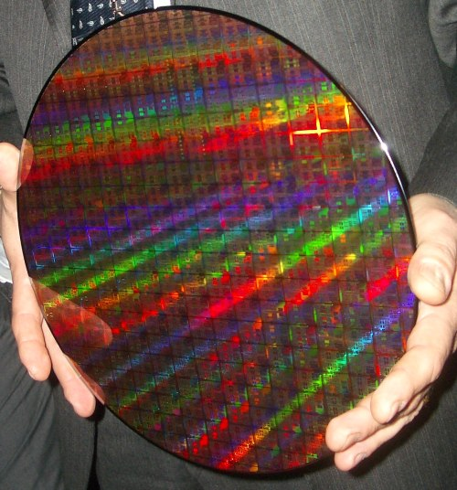
Integrated Circuits
AMD 45nm wafer
http://www.theinquirer.net/inquirer/news/1005483/amd-shows-45nm

Slide 33
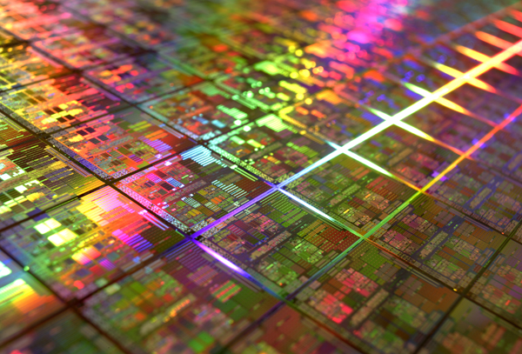
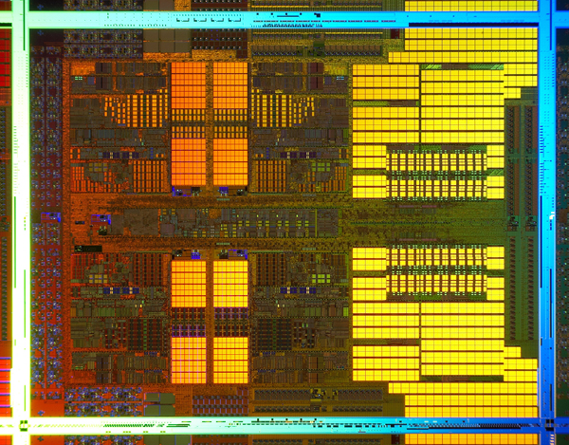
Integrated Circuits
AMD 45nm Quad Core wafer
http://www.amd.com/us-en/0,,3715_15503,00.html
Single AMD 45nm Quad Core die
http://www.amd.com/us-en/0,,3715_15503,00.html

Slide 34
Generations of Computer
Vacuum tube - 1946-1957
Transistor - 1958-1964
Small scale integration - 1965 on
Up to 100 devices on a chip
Medium scale integration - to 1971
100-3,000 devices on a chip
Large scale integration - 1971-1977
3,000 - 100,000 devices on a chip
Very large-scale integration - 1978 -1991
100,000 - 100,000,000 devices on a chip
Ultra large-scale integration – 1991 -
Over 100,000,000 devices on a chip
Notes:
34

Slide 35


Slide 36
Moore’s Law
Increased density of components on chip
Gordon Moore – co-founder of Intel
Number of transistors on a chip will double every year
Since 1970’s development has slowed a little
Number of transistors doubles every 18 months
Cost of a chip has remained almost unchanged
Notes:
36
Moore's Law is an observation and prediction made by Gordon Moore, a co-founder of Intel Corporation, in 1965.
It has been a guiding principle in the semiconductor industry and the field of computing for several decades.
Moore's Law states that the number of transistors on a microchip (or integrated circuit) roughly doubles approximately every two years, while the cost of these chips remains roughly the same or decreases.

Slide 37
Moore’s Law
Higher packing density means shorter electrical paths, giving higher performance
Smaller size increased flexibility
Reduced power and cooling requirements
Fewer interconnections increase reliability
Notes:
37
The cost of a chip has remained virtually unchanged during this period of rapid growth in density. This means that the cost of computer logic and memory circuitry has fallen at a dramatic rate.
Because logic and memory elements are placed closer together on more densely packed chips, the electrical path length is shortened, increasing operating speed
The computer becomes smaller, making it more convenient to place in a variety of environments.
The interconnections on the integrated circuit are much more reliable than solder connections. With more circuitry on each chip, there are fewer interchip connections.

Slide 38
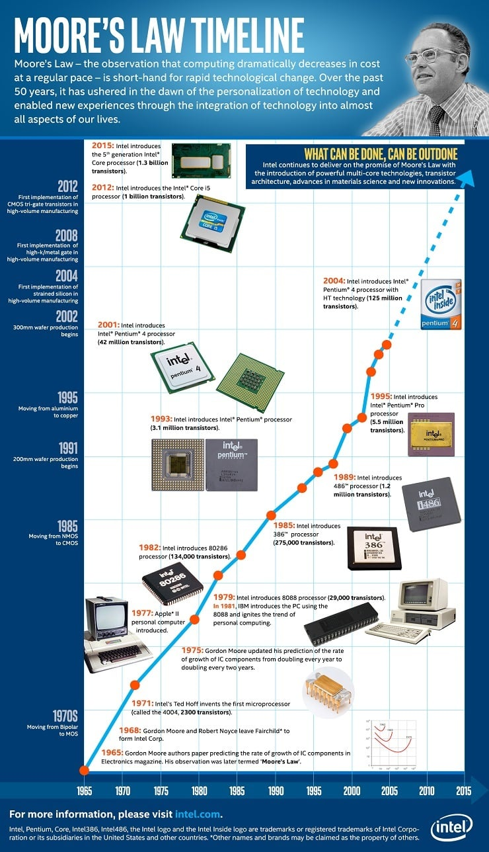

Slide 39
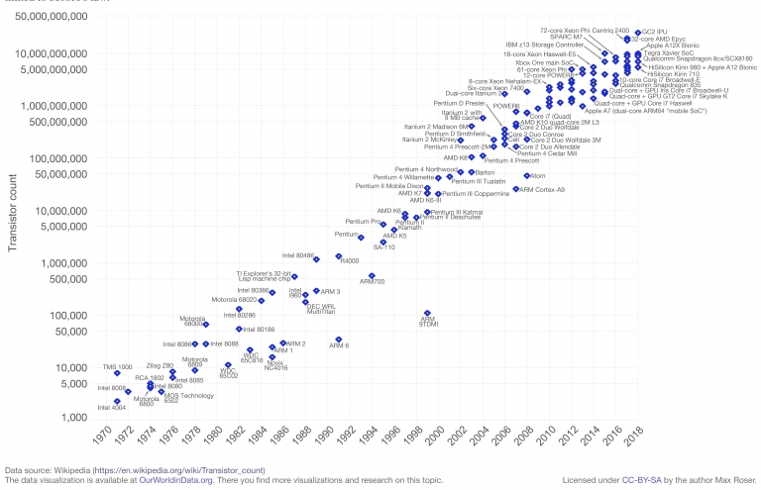
Growth in CPU Transistor Count
Notes:
39

Slide 40

Moore’s Law
Notes:
40

Slide 41
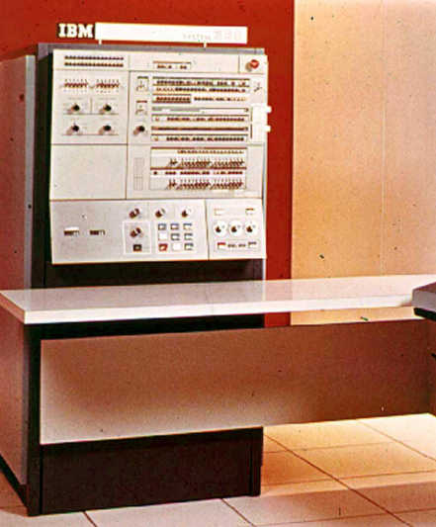
IBM 360 series
A family of mainframe computer systems introduced by IBM in 1964
Replaced (& not compatible with) 7000 series
The architecture remains that of IBM’s mainframe computers today
Notes:
41
t marked a significant milestone in the history of computing because it was the first series of computers designed to be compatible in terms of both hardware and software.
The System/360 series revolutionized the computer industry and had a deep impact on business, science, and technology. Here are some key points about the IBM System/360:

Slide 42
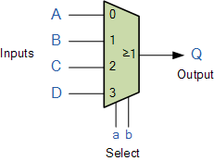
IBM 360 series
First planned “family” of computers
Similar or identical instruction sets
Similar or identical O/S
Increasing speed
Increasing number of I/O ports (i.e. more terminals)
Increasing memory size
Increasing cost
Multiplexed-switch structure (central-switched)
Notes:
42
The IBM System/360 (S/360) is a family of mainframe computer systems that was announced by IBM on April 7, 1964, and delivered between 1965 and 1978.
It was the first family of computers designed to cover both commercial and scientific applications and a complete range of applications from small to large.
The System/360 family introduced IBM's Solid Logic Technology (SLT), which packed more transistors onto a circuit card, allowing more powerful but smaller computers.
Multiplexing is the generic term used to describe the operation of sending one or more analogue or digital signals over a common transmission line at different times or speeds and as such, the device we use to do just that is called the multiplexer.

Slide 43
DEC PDP-8
1964
First minicomputer (after miniskirt!)
Did not need air-conditioned room
Small enough to sit on a lab bench
$16,000
Compared to $100k+ for IBM 360
Notes:
43
The PDP-8 is a family of 12-bit minicomputers that was produced by Digital Equipment Corporation (DEC). It was the first commercially successful minicomputer,

Slide 44
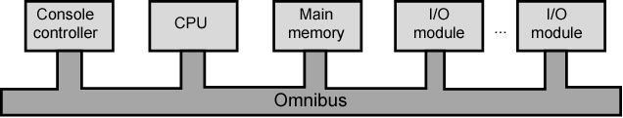
DEC PDP-8
Embedded applications & OEM
Another manufacturer can integrate PDP-8 into a total system for resale
Bus structure
Notes:
44
The DEC PDP-8, also known as the Programmed Data Processor-8, was a pioneering minicomputer introduced by Digital Equipment Corporation (DEC) in 1965.
It holds the distinction of being one of the first commercially successful minicomputers and played a significant role in the early history of computing.

Slide 45
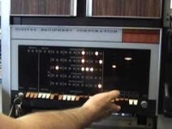

Slide 46
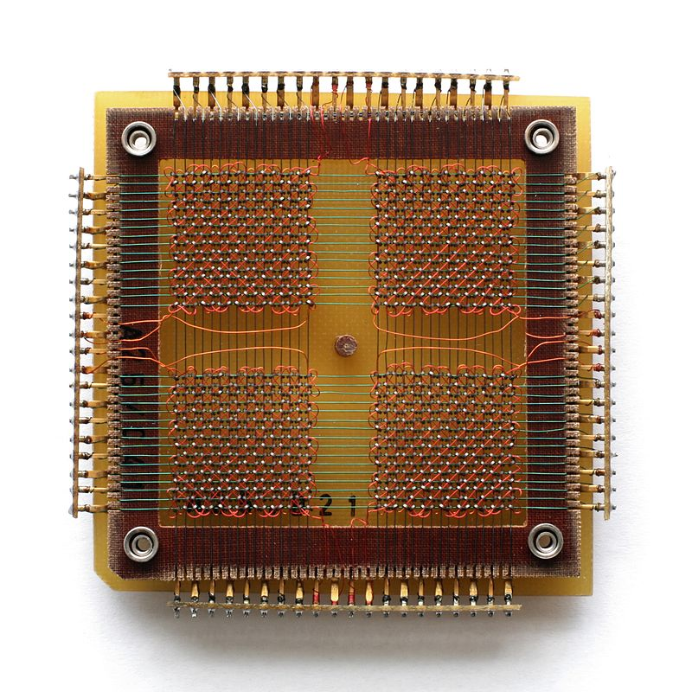
Later Generations: Semiconductor Memory
ICs were initially used for processors (ALU, CU), later used for memory
Previously memory made of ferromagnetic material (core) which is expensive, bulky, destructive readout
32 x 32 Core Memory
https://en.wikipedia.org/wiki/Magnetic-core_memory#/media/File:KL_CoreMemory.jpg
Notes:
46

Slide 47
Semiconductor Memory
Semiconductor Memory
1970, Fairchild introduced a chip of the size of a single core (about 1.5mm) which could hold 256 bits
Non-destructive read & much faster than core but expensive
Capacity approximately doubles each year
Notes:
47

Slide 48
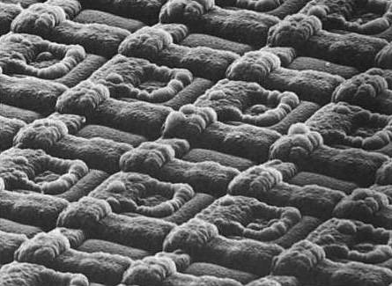
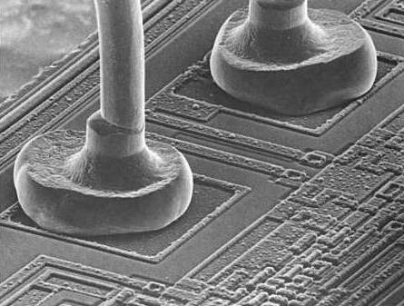
Later Generations: Semiconductor Memory
EPROM cells (transistors)
EPROM connecting wires
J. Burgess, M. Marten and R. Taylor, Under the microscope: a hidden world revealed, Cambridge University Press, 1990.
Notes:
EPROM, in full erasable programmable read-only memory, form of computer memory that does not lose its content when the power supply is cut off and that can be erased and reused.

Slide 49
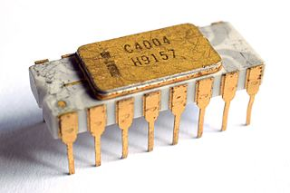
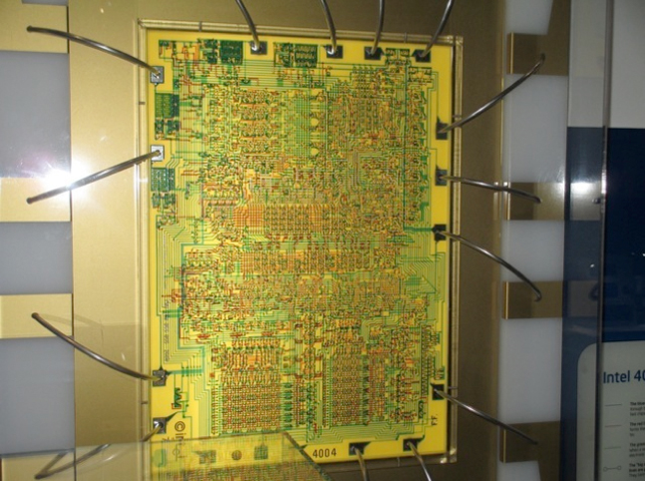
Microprocessors
1971 Intel introduced 4004
First microprocessor
All CPU components on a single chip
4 bit
Source: https://commons.wikimedia.org/wiki/File:Intel_C4004.jpgE%D1%80_Intel_4004.jpg; http://www.intel4004.com/current_intel_museum.htm
Notes:
49
A microprocessor is a central processing unit (CPU) that is contained on a single integrated circuit (IC) or microchip. It serves as the brain of a computer or other electronic device, executing instructions and performing calculations.
Microprocessors are a fundamental component of modern computing and have a wide range of applications, from personal computers to smartphones, embedded systems, and more.

Slide 50
Microprocessors
Followed in 1972 by 8008
8 bit
Both designed for specific applications
1974 8080
Intel’s first general purpose microprocessor
Notes:
50

Slide 51
Microprocessors
End 1970s powerful, general purpose 16-bit microprocessor appeared
8086
1981 Bell Lab & Hewlett-Packard introduced 32-bit, single-chip processor
1985 80386

Slide 52
What computer did you first get acquainted with?
What did you use it for?
Pair-Share
Source: https://www.flickr.com/photos/nubui/9550939064

Slide 53
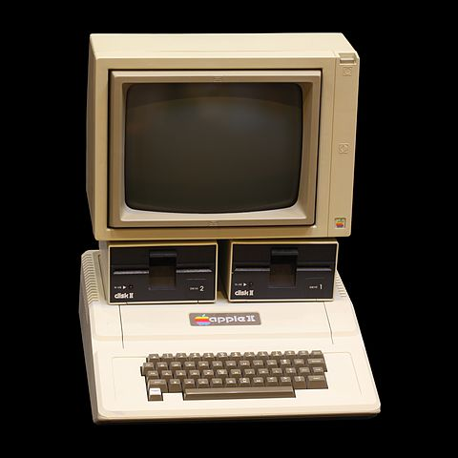

MOS 6502 chip
Source: https://www.flickr.com/photos/nubui/9550939064; https://en.wikipedia.org/wiki/Apple_II#/media/File:Apple_II_IMG_4212.jpg; https://en.wikipedia.org/wiki/MOS_Technology_6502#/media/File:MOS_6502AD_4585_top.jpg

Slide 55
Outline
History of computers
X86, PowerPC and ARM evolution
Organisation and architecture
Structure and function
Computer evolution and performance
Cloud Computing
Performance Issues

Slide 56
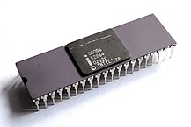
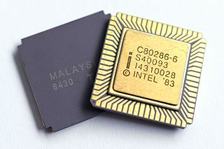
x86 Evolution
8080 (1974)
first general-purpose microprocessor
8-bit data path
Used in first personal computer – Altair
8086 (1978)
much more powerful
16 bit
instruction cache, prefetch few instructions
8088 (8-bit external bus) used in first IBM PC
80286 (1982)
16 Mbyte memory addressable
up from 1Mb
Source: https://en.wikipedia.org/wiki/Intel_8086#/media/File:Intel_C8086.jpg; https://commons.wikimedia.org/wiki/File:Intel_C80286-6.jpg
Notes:
For this course, we will focus on two processor families:
Intel x86
ARM architectures
x86 offerings represent the results of decades of design effort on complex instruction set computers (CISCs)
x86 incorporates the sophisticated design principles once found only on mainframes and supercomputers and serves as an excellent example of CISC design.

Slide 57
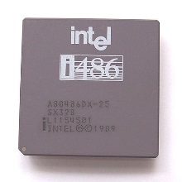
x86 Evolution
80386 (1985)
32 bit
Support for multitasking
80486 (1989)
sophisticated powerful cache and instruction pipelining
built in maths co-processor
Source: https://commons.wikimedia.org/wiki/File:Intel_i486_DX_25MHz_SX328.jpg
Notes:
Instruction pipelining is a technique of organising the instructions for execution in such a way that the execution of the current instruction is overlapped by the execution of its subsequent instruction. Instruction pipelining improves the performance of the processor by increasing its throughput i.e. number of instructions per unit time.

Slide 58
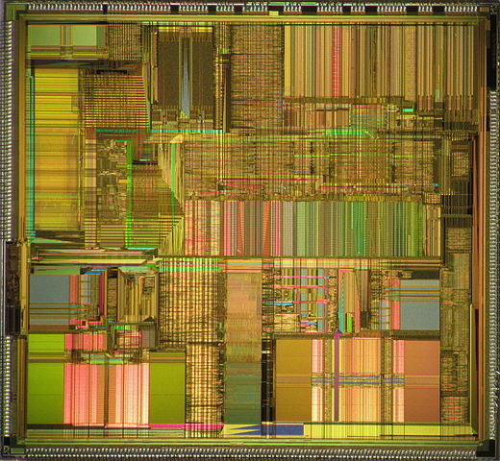
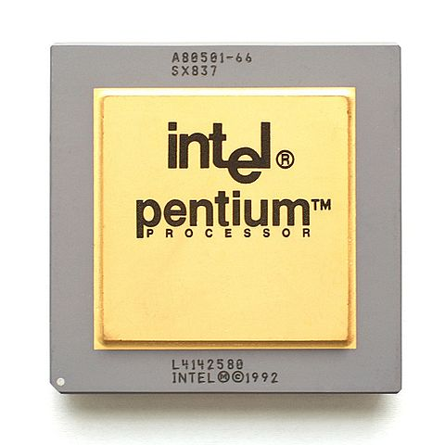
x86 Evolution
Pentium (1993)
Superscalar
Multiple instructions executed in parallel
Source: https://commons.wikimedia.org/wiki/File:Intel_Pentium_P54C_die.jpg
Notes:
a superscalar processor can execute more than one instruction during a clock cycle by simultaneously dispatching multiple instructions to different execution units on the processor.

Slide 59
x86 Evolution
Pentium Pro (1995)
Increased superscalar organization
Aggressive register renaming
branch prediction
data flow analysis
speculative execution
Pentium II (1997)
MMX technology
graphics, video & audio processing
Pentium III (1999)
Additional floating-point instructions for 3D graphics

Slide 60
x86 Evolution
Pentium 4 (2000)
Note Arabic rather than Roman numerals
Further floating point and multimedia enhancements
Core (2006)
First x86 with dual core

Slide 61
x86 Evolution
Core 2 (2006)
64-bit architecture
Core 2 Quad (2008)
3GHz, 820 million transistors
Four processors on chip

Slide 62
x86 Evolution
(a) 1970s Processors
Notes:
About the same time, 16-bit microprocessors began to be developed.
However, it was not until the end of the 1970s that powerful, general-purpose 16-bit microprocessors
appeared.
One of these was the 8086. The next step in this trend occurred in 1981, when both Bell Labs and Hewlett-Packard developed 32-bit, single- chip microprocessors. Intel introduced its own 32-bit microprocessor, the 80386, in 1985 (Table 1.3).
CPU speed is determined by how many calculations the processor can perform per cycle. Clock speed is expressed in gigahertz — billions of cycles per second.

Slide 63
x86 Evolution
(b) 1980s Processors
Notes:
Table 1.3 (continued)

Slide 64
x86 Evolution
(c) 1990s Processors
Notes:
Table 1.3 (continued)

Slide 65
x86 Evolution
(d) Recent Processors
Notes:
Table 1.3 (continued)

Slide 66
x86 Evolution
x86 architecture dominant outside embedded systems
Organization and technology changed dramatically
Instruction set architecture evolved with backwards compatibility
~1 instruction per month added
500 instructions available
See Intel web pages for detailed information on processors

Slide 67
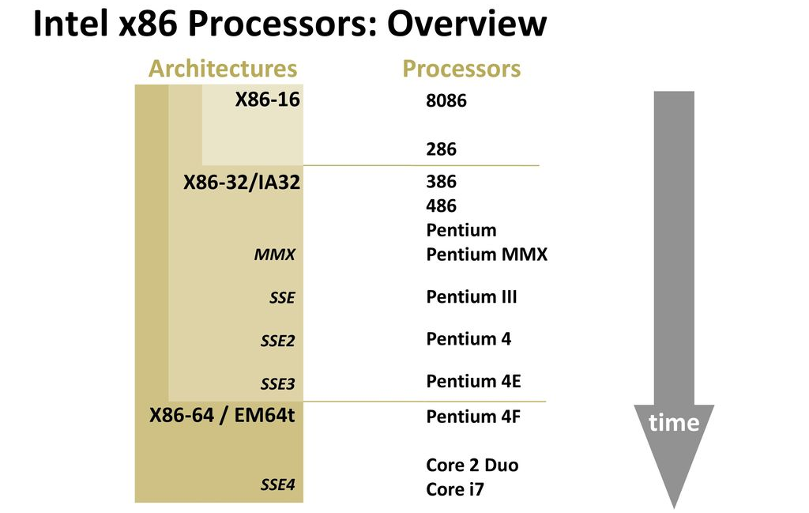

Slide 68
PowerPC
1975, 801 minicomputer project (IBM) RISC
Berkeley RISC I processor
1986, IBM commercial RISC workstation product, RT PC.
Not commercial success
Many rivals with comparable or better performance
1990, IBM RISC System/6000
RISC-like superscalar machine
POWER architecture
Notes:
An alternative approach to processor design is the reduced instruction set computer (RISC).
A reduced instruction set computer (RISC) is a computer architecture designed to simplify the individual instructions given to the computer to accomplish tasks.
Compared to the instructions given to a complex instruction set computer (CISC), a RISC computer might require more instructions (more code) in order to accomplish a task because the individual instructions are written in simpler code.

Slide 69
PowerPC
IBM alliance with Motorola (68000 microprocessors), and Apple, (used 68000 in Macintosh)
Result is PowerPC architecture
Derived from the POWER architecture
Superscalar RISC
Apple Macintosh
Embedded chip applications

Slide 70
PowerPC Family
601:
Quickly to market. 32-bit machine
603:
Low-end desktop and portable
32-bit
Comparable performance with 601
Lower cost and more efficient implementation
604:
Desktop and low-end servers
32-bit machine
Much more advanced superscalar design
Greater performance

Slide 71
PowerPC Family
620:
High-end servers
64-bit architecture
740/750:
Also known as G3
Two levels of cache on chip
G4 (1999-2004):
Increases parallelism and internal speed
G5 (2003-2006):
Improvements in parallelism and internal speed
64-bit organization

Slide 72

Although the organization and technology of the x86 machines have changed dramatically over the decades, the instruction set architecture has evolved to remain backward compatible with earlier versions.
Any program written on an older version of the x86 architecture can execute on newer versions

Slide 73
Embedded Systems ARM
ARM evolved from RISC design
Used mainly in embedded systems
Used within product
Not general-purpose computer
Dedicated function
E.g. Anti-lock brakes in car, household appliances, automotive airbag
Notes:
The term embedded system refers to the use of electronics and software within a product, as opposed to a general-purpose computer, such as a laptop or desktop system.
An embedded system is a specialized computer system designed to perform dedicated functions or tasks within a larger system, often with real-time constraints and specific hardware requirements.

Slide 74
Embedded Systems Requirements
Different sizes
Different constraints, optimization, reuse
Different requirements
Safety, reliability, real-time, flexibility, legislation
Lifespan
Environmental conditions
Static v dynamic loads
Slow to fast speeds
Computation v I/O intensive
Discrete event v continuous dynamics

Slide 75
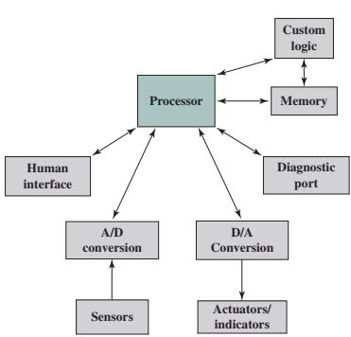
Possible Organization of an Embedded System
Notes:
Embedded systems often interact (sense, manipulate, and communicate) with the external world through sensors and actuators, and hence are typically reactive systems; a reactive system is in continual interaction with the environment and executes at a pace determined by that environment
The diagnostic port may be used for diagnosing the system that is being controlled—not just for diagnosing the computer.
Software often has a fixed function and is specific to the application.

Slide 76
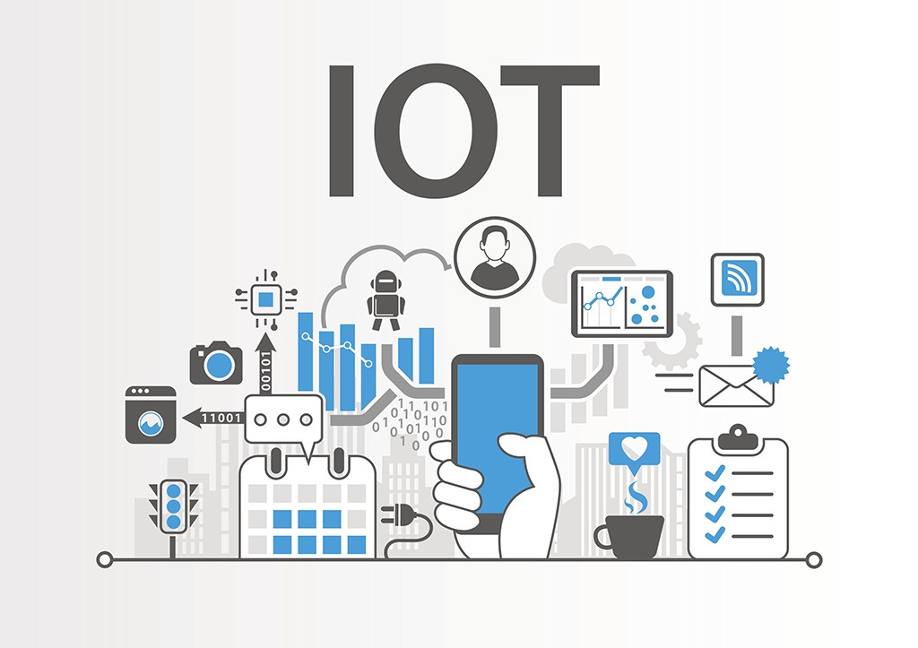
The Internet of Things (IoT)
Expanding interconnection of smart devices, ranging from appliances to tiny sensors
Driven by deeply embedded devices.
Notes:
The Internet of things (IoT) is a term that refers to the expanding interconnection of smart devices, ranging from appliances to tiny sensors.
A dominant theme is the embedding of short-range mobile transceivers into a wide array of gadgets and everyday items
enabling new forms of communication between people and things, and between things themselves.

Slide 77
IoT evolution
Information Technology (IT)
Operational Technology (OT)
Personal Technology
Sensor/actuator Technology
PCs, servers, routers, firewalls
Machines with embedded IT built
Smartphones, tablets, eBook
Single-purpose devices bought by customers using
(wired connectivity)
(wired connectivity)
(wireless connectivity)
(wireless connectivity)

Slide 78
ARM Evolution
Designed by ARM Inc., Cambridge, England
Licensed to manufacturers
High speed, small die size, low power consumption

Slide 79
ARM Evolution
PDAs, handheld games, phones
E.g. iPod, iPhone
Acorn produced ARM1 & ARM2 in 1985 and ARM3 in 1989
Acorn, VLSI and Apple Computer founded ARM Ltd.

Slide 80
ARM Products
Cortex-M
Cortex-M0
Cortex-M0+
Cortex-M3
Cortex-M4
:
:
Cortex-M55
Cortex-R
Cortex-R4(F)
Cortex-R5(F)
:
:
Cortex-R52(F)
Cortex-R82(F)
Cortex-A
Cortex-A5
Cortex-A7
:
:
Cortex-A77
Cortex-A78

Slide 81
ARM Cortext-M3-based Microcontroller

Slide 82

Quick Research
Cortex-M
Cortex-R
Cortex-A
What’s the difference between the Cortex A, R, and M series?
Source: https://commons.wikimedia.org/wiki/File:Stopwatch_ballonicon2.svg

Slide 83
ARM Systems Categories
Embedded real time, safety-critical
Application platform
Linux, Palm OS, Symbian OS, Windows mobile, Android
Microcontrollers

Slide 84
Outline
History of computers
X86, PowerPC and ARM evolution
Organisation and architecture
Structure and function
Computer evolution and performance
Cloud Computing
Performance Issues

Slide 85
Cloud Computing
Internet-connected infrastructure
Model for enabling ubiquitious, convenient, on-demand network access to a shared pool of configurable computing resources… (NIST)

Slide 86
Cloud Services
Software as a Service (SaaS)
Application software running on and accessible in the cloud.
E.g. Google Apps, Microsoft Office 365, Dropbox, …

Slide 87
Cloud Services
Platform as a Service (PaaS)
Platform on which customer’s applications can run.
Software building blocks, development/programming tools, and environments to deploy new applications.
E.g. Windows Azure, Google App Engine, …

Slide 88
Cloud Services
Infrastructure as a Service (IaaS)
Access to cloud infrastructure.
Processing, storage, networks, and other resources.
E.g. Windows Azure, Google Compute Engine, Amazon Web Services, …

Slide 89
Outline
History of computers
X86, PowerPC and ARM evolution
Organisation and architecture
Structure and function
Computer evolution and performance
Cloud Computing
Performance Issues

Slide 90
Performance Assessment
Key parameters
Performance
Cost
Size
Security
Reliability
Power consumption
Notes:
Year by year, the cost of computer systems continues to drop dramatically, while the performance and capacity of those systems continue to rise equally dramatically.
Today’s laptops have the computing power of an IBM mainframe from 10 or 15 years ago. Thus, we have virtually “free” computer power. Processors are so inexpensive that we now have microprocessors we throw away.
For example, desktop applications that require the great power of today’s microprocessor-based systems include:
Image processing
Three-dimensional rendering
Speech recognition
Videoconferencing
Multimedia authoring
Voice and video annotation of files
Simulation modeling

Slide 91
Clock Speed
The speed of a processor is dictated by the pulse frequency produced by the clock, measured in
cycles per second
Hertz (Hz)
Clock signals are generated by a quartz crystal, which generates a constant sine wave while power is applied. This wave is converted into a digital voltage
Signals in CPU take time to settle down to 1 or 0
Signals may change at different speeds
Operations need to be synchronised
Instruction execution in discrete steps
Fetch, decode, load and store, arithmetic or logical
Usually require multiple clock cycles per instruction
Pipelining gives simultaneous execution of instructions
Notes:
Operations performed by a processor, such as fetching an instruction, decoding the instruction, performing an arithmetic operation, and so on, are governed by a system clock
The execution of an instruction involves a number of discrete steps, such as fetching the instruction from memory, decoding the various portions of the instruction, loading and storing data, and performing arithmetic and logical operations.
Thus, most instructions on most processors require multiple clock cycles to complete.
Some instructions may take only a few cycles, while others require dozens.
In addition, when pipelining is used, multiple instructions are being executed simultaneously.
Thus, a straight comparison of clock speeds on different processors does not tell the whole story about performance.

Slide 92
Clock Speed
Rate of pulse = clock rate /clock speed
One increment of pulse = clock cycle
Time between pulses = cycle time

Slide 93
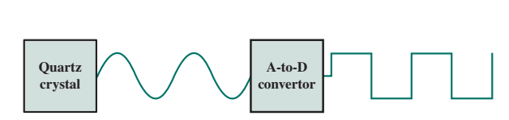
System Clock
Sine wave
Digital Voltage
Notes:
Typically, clock signals are generated by a quartz crystal, which generates a constant sine wave while power is applied. This wave is converted into a digital voltage pulse stream that is provided in a constant flow to the processor circuitry (Figure 2.5). For example, a 1-GHz processor receives 1 billion pulses per second

Slide 94
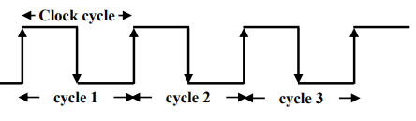
Instruction Execution Rate
Most computers run synchronously utilizing a CPU clock running at a constant clock rate, where clock rate = 1/f
The CPU clock rate depends on the specific CPU organization (design) and hardware implementation technology (VLSI) used
A single machine instruction may take one or more CPU cycles to complete termed as the Cycles Per Instruction (CPI).
t= 1/f
Notes:
A processor is driven by a clock with a constant frequency f or, equivalently, a constant cycle time t, where t = 1/f
Note that this is the number of instruction executions, not the number of instructions in the object code of the program.
An important parameter is the average cycles per instruction (CPI) for a program. If all instructions required the same number of clock cycles, then CPI would be a constant value for a processor.

Slide 95
Cycle per instruction (CPI)
Cycle/sec = Hertz = Hz
MHz = 10⁶ Hz
GHz = 10⁹ Hz

Slide 96
Average instruction (CPI)
What’s an “average instruction” (CPI)?
Given a program, how many cycles does an instruction typically take?
Depends on how many instructions and what are the types of instructions
E.g. all addition vs all loads for multi-cycle implementation

Slide 97
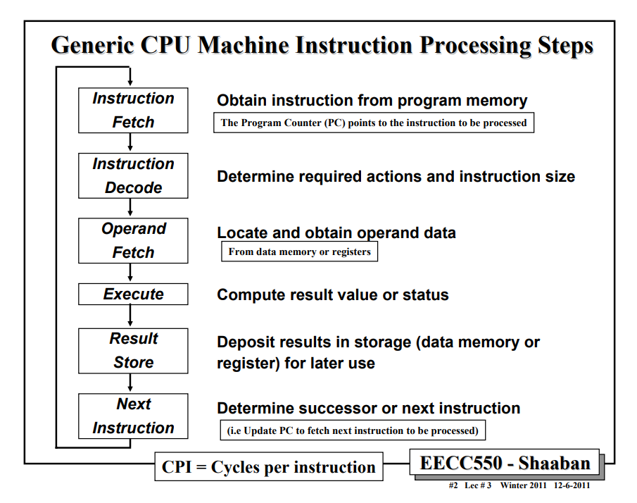

Slide 98

Instruction Execution Rate
A common measure of performance for a processor is the rate at which instructions are executed, expressed as millions of instructions per second (MIPS)

Slide 99
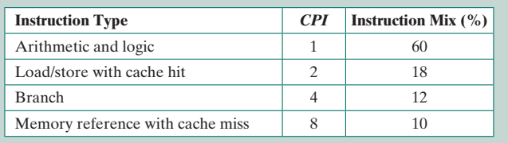
MIPS calculation
% total instructions count corresponding to each instruction class
Consider the execution of a program that results in the execution of 2 million instructions on a 400-MHz processor. The program consists of four major types of instructions. The instruction mix and the CPI for each instruction type are given below, based on the result of a program trace experiment:

Slide 100
Step 1: Calculate the CPI
CPI = (1x0.6) +(2x0.18) + (4x0.12) + (8x0.1) = 2.24
Step 2: Calculate the MIPS
MIPS rate = (400x10⁶) /(2.24 x 10⁶) ~ 178

Slide 101
Quick activity
Calculate the MIPS based on the information given below:
Instruction type | CPI | Instruction Mix (%)
Fetch | 2 | 12
Load/store | 4 | 18
Decode | 2 | 20
Arithmetic & logic | 5 | 50

Slide 102
Benchmarks
Measures such as MIPS and MFLOPS have proven inadequate to evaluating the performance of processors.
Because of differences in instruction sets, the instruction execution rate is not a valid means of comparing the performance of different architectures
Alternatively, we use benchmarks: Programs designed to test performance
Written in high level language
Represents style of task - Systems, numerical, commercial
Easily measured
Widely distributed
Notes:
The same set of programs can be run on different machines and the execution times compared.
Benchmarks provide guidance to customers trying to decide which system to buy, and can be useful to vendors and designers in determining how to design systems to meet benchmark goals
It is written in a high-level language, making it portable across different machines.
It is representative of a particular kind of programming domain or paradigm, such as systems programming, numerical programming, or commercial programming.
It can be measured easily.
It has wide distribution

Slide 103
Benchmarks: SPEC
System Performance Evaluation Corporation (SPEC)
CPU2017 for computation bound
floating point programs
integer programs
Speed and rate metrics
Single task and throughput
The best known of the SPEC benchmark suites is SPEC CPU2017.
This is the industry standard suite for processor-intensive applications.
https://www.spec.org/benchmarks.html
Notes:
SPEC benchmarks are widely used to evaluate the performance of computer systems
The common need in industry and academic and research communities for generally accepted computer performance measurements has led to the development of standardized benchmark suites.
A benchmark suite is a collection of programs, defined in a high-level language, that together attempt to provide a representative test of a computer in a particular application or system programming area.

Slide 104
SPEC suites
SPEC Cloud_IaaS - addresses the performance of infrastructure-as-a-service (IaaS) public or private cloud platforms
SPECviewperf - measuring 3D graphics performance based on professional applications
SPECwpc - measure all key aspects of workstation performance based on diverse professional applications, including media and entertainment, product development, life sciences, financial services, and energy
SPECjvm2008 - evaluate performance of the combined hardware and software aspects of the Java Virtual Machine (JVM) client platform
SPECjbb2015 (Java Business Benchmark) - evaluating server-side Java-based electronic commerce applications.
SPECsfs2014 - evaluate the speed and request-handling capabilities of file servers
SPECvirt_sc2013 - Performance evaluation of datacenter servers used in virtualized server consolidation. Measures the end-to-end performance of all system components

Slide 105
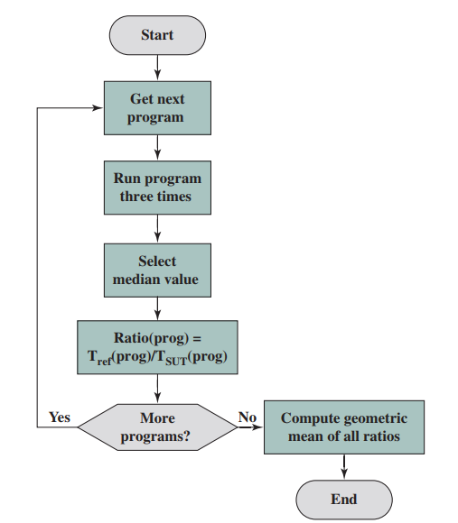
SPEC Evaluation Flowchart

Slide 106
Amdahl’s Law
Gene Amdahl [AMDA67]
Potential speed up of program using multiple processors
Concluded that:
Code needs to be parallelizable
Speed up is bound, giving diminishing returns for more processors
Notes:
Computer system designers look for ways to improve system performance by advances in technology or change in design.
Examples include the use of parallel processors, the use of a memory cache hierarchy, and speedup in memory access time and I/O transfer rate due to technology improvements.
In all of these cases, it is important to note that a speedup in one aspect of the technology or design does not result in a corresponding improvement in performance. This limitation is succinctly expressed by Amdahl’s law
The formula, which makes a prediction about the maximum performance improvement that can be expected from parallel computing
Amdahl's Law is a fundamental concept in computer science and parallel computing that was formulated by computer architect Gene Amdahl in 1967. It is used to estimate the potential speedup that can be achieved when parallelizing a computational task. Amdahl's Law is particularly relevant in situations where a program or algorithm is divided into parallel and serial (or sequential) components.

Slide 107
Amdahl’s Law
Task dependent, e.g.:
Servers gain by maintaining multiple connections on multiple processors
Databases can be split into parallel tasks
Notes:
Amdahl's Law highlights the importance of optimizing the parallelizable portions of a program and minimizing the serial portions when attempting to improve the performance of parallel computing systems.
It serves as a valuable tool for understanding the trade-offs and limitations of parallelization in practical computing scenarios.

Slide 108
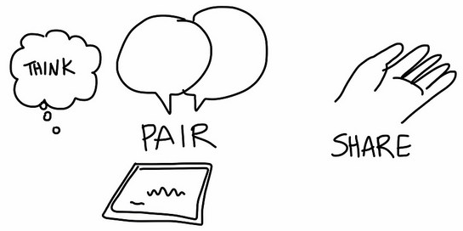
A dual core processor is not necessarily faster than a single core processor
True or false?
Why?

Slide 109
Internet Resources
http://www.intel.com/
Search for the Intel Museum
http://www.ibm.com
http://gordonbell.azurewebsites.net/digital/timeline/tmlnhome.htm
Charles Babbage Institute
PowerPC
Intel Developer Zone
Notes:
109

Slide 110
Internet Resources Websites to look for
WWW Computer Architecture Home Page
CPU Info Center
Processor Emporium
ACM Special Interest Group on Computer Architecture
IEEE Technical Committee on Computer Architecture
Intel Technology Journal
Manufacturer’s sites
Intel, IBM, etc.

Slide 111

Reflection…
From the lecture today,
I learnt…
Link on eLearn / Chat
Image source: https://www.flickr.com/photos/29143375@N05/4582236533

